Slide 1
Socket Programming

Slide 2
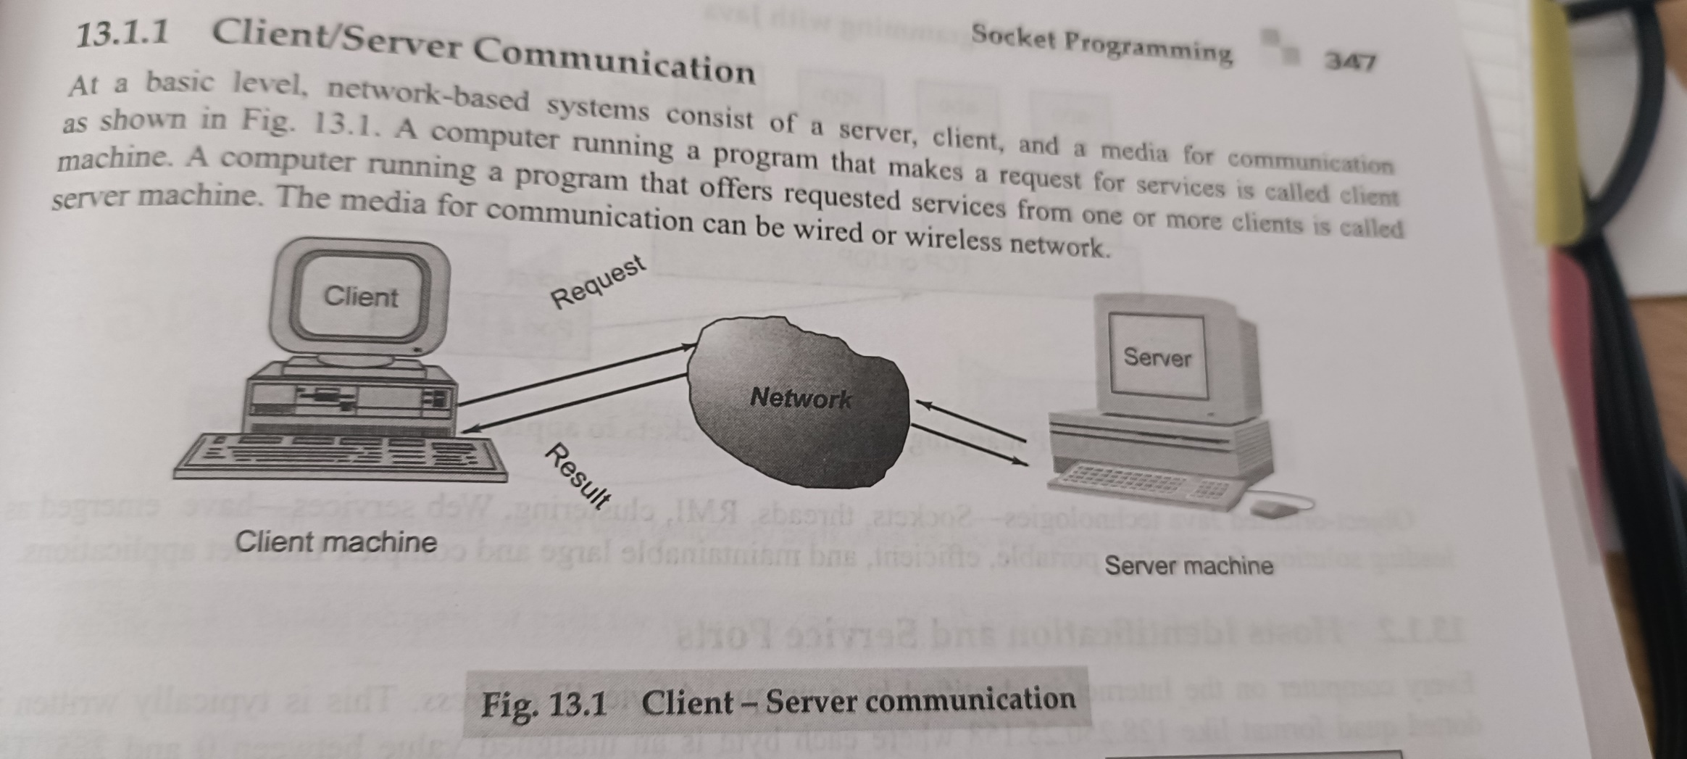

Slide 3
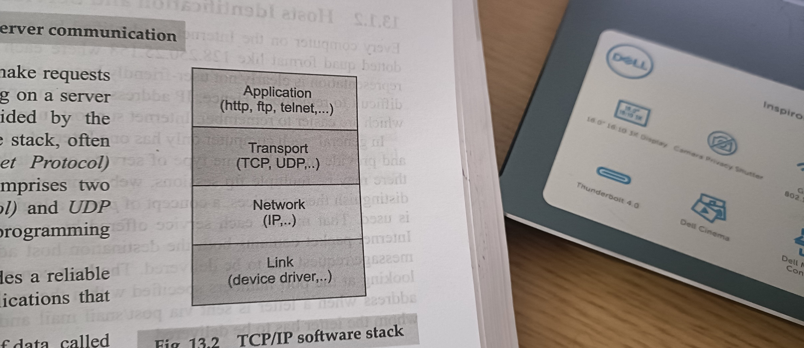

Slide 4
Port Number
Host identification
A port number is a way to identify a specific process to which an internet or other network message is to be forwarded when it arrives at a server.
Each application is assigned one port number
Hypertext Transfer Protocol (HTTP) messages, for example, always go to port 80 -- one of the most commonly used ports.
A socket is an end point of a two way communication link between two programs running on the network

Slide 5
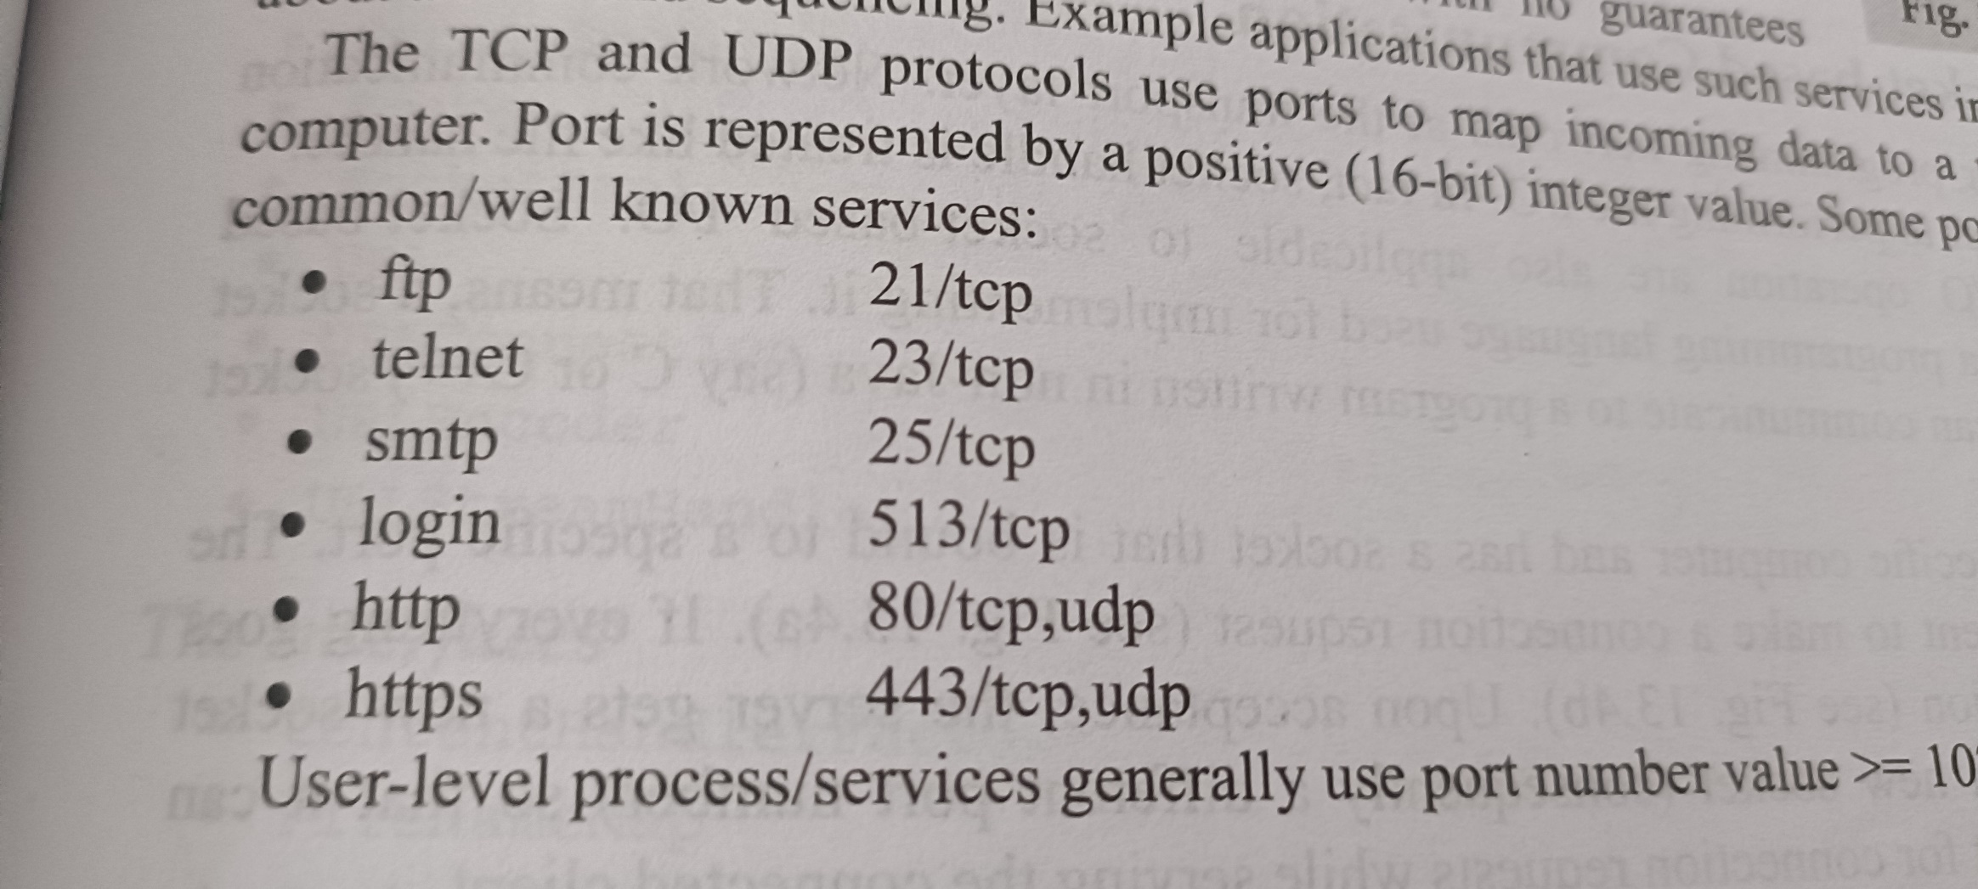

Slide 6
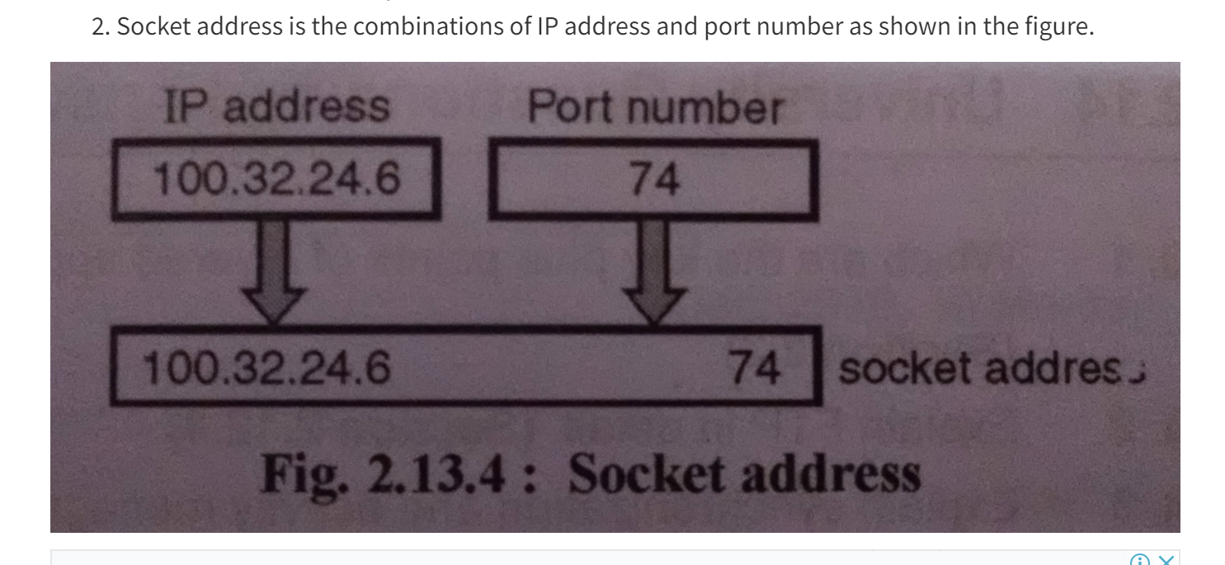
Socket Address

Slide 7
TCP/IP Server
Initialize socket and input stream
Start server and waits for a connection
Takes input from the client socket
Close connection

Slide 8
TCP/IP Client
Initialize socket and input output streams
Establish a connection
Take input from terminal
Send output to the socket
Close the connection

Slide 9
UDP Server
Step 1 : Create a socket to listen at port
Step 2 : create a DatgramPacket to receive the data.
Step 3 : Revive the data in byte buffer.
Step 4: Exit the server if the client sends "bye"

Slide 10
UDP Client
Step 1:Create the socket object for carrying the data.
Step 2:Ask user to enter data
Step 3:convert the String input into the byte array.
Step 4 : Create the datagramPacket for sending the data.
Step 5 : invoke the send call to actually send the data.

